Slide 1
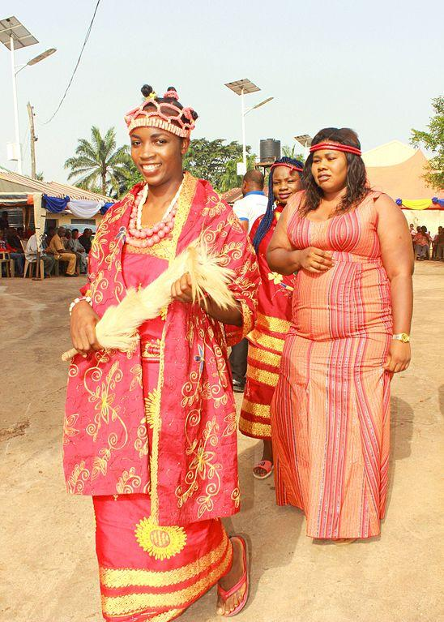
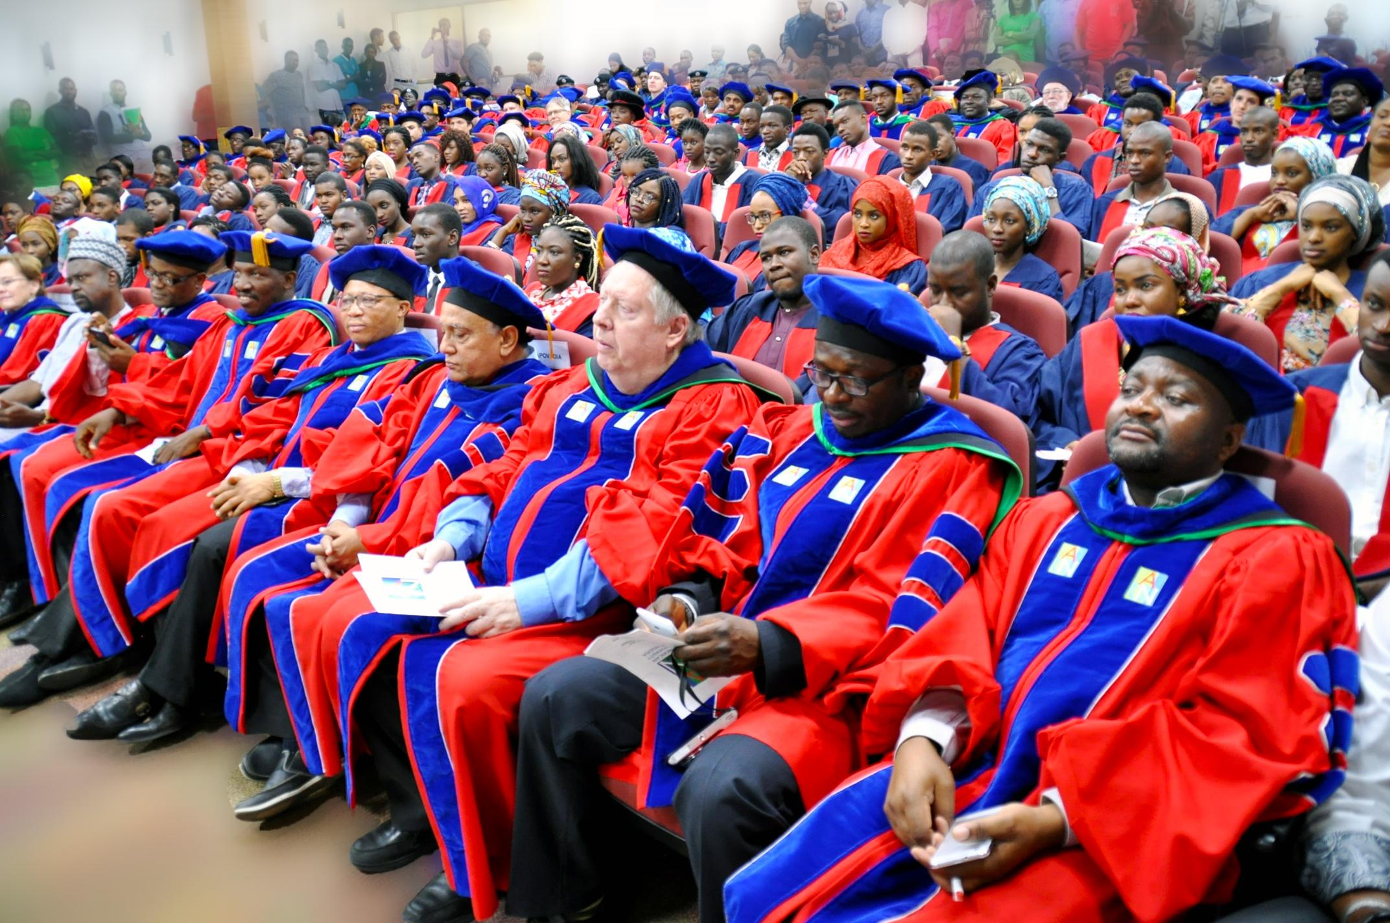
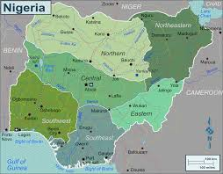
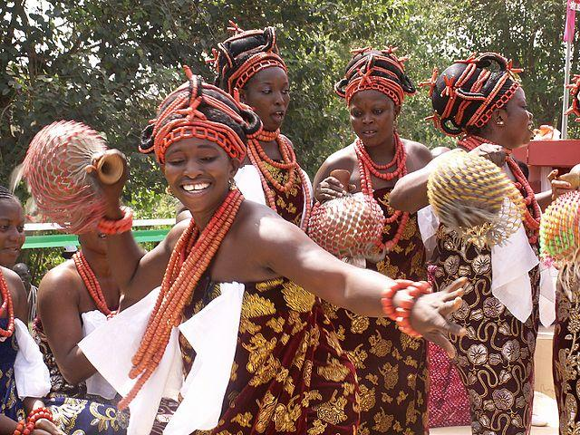
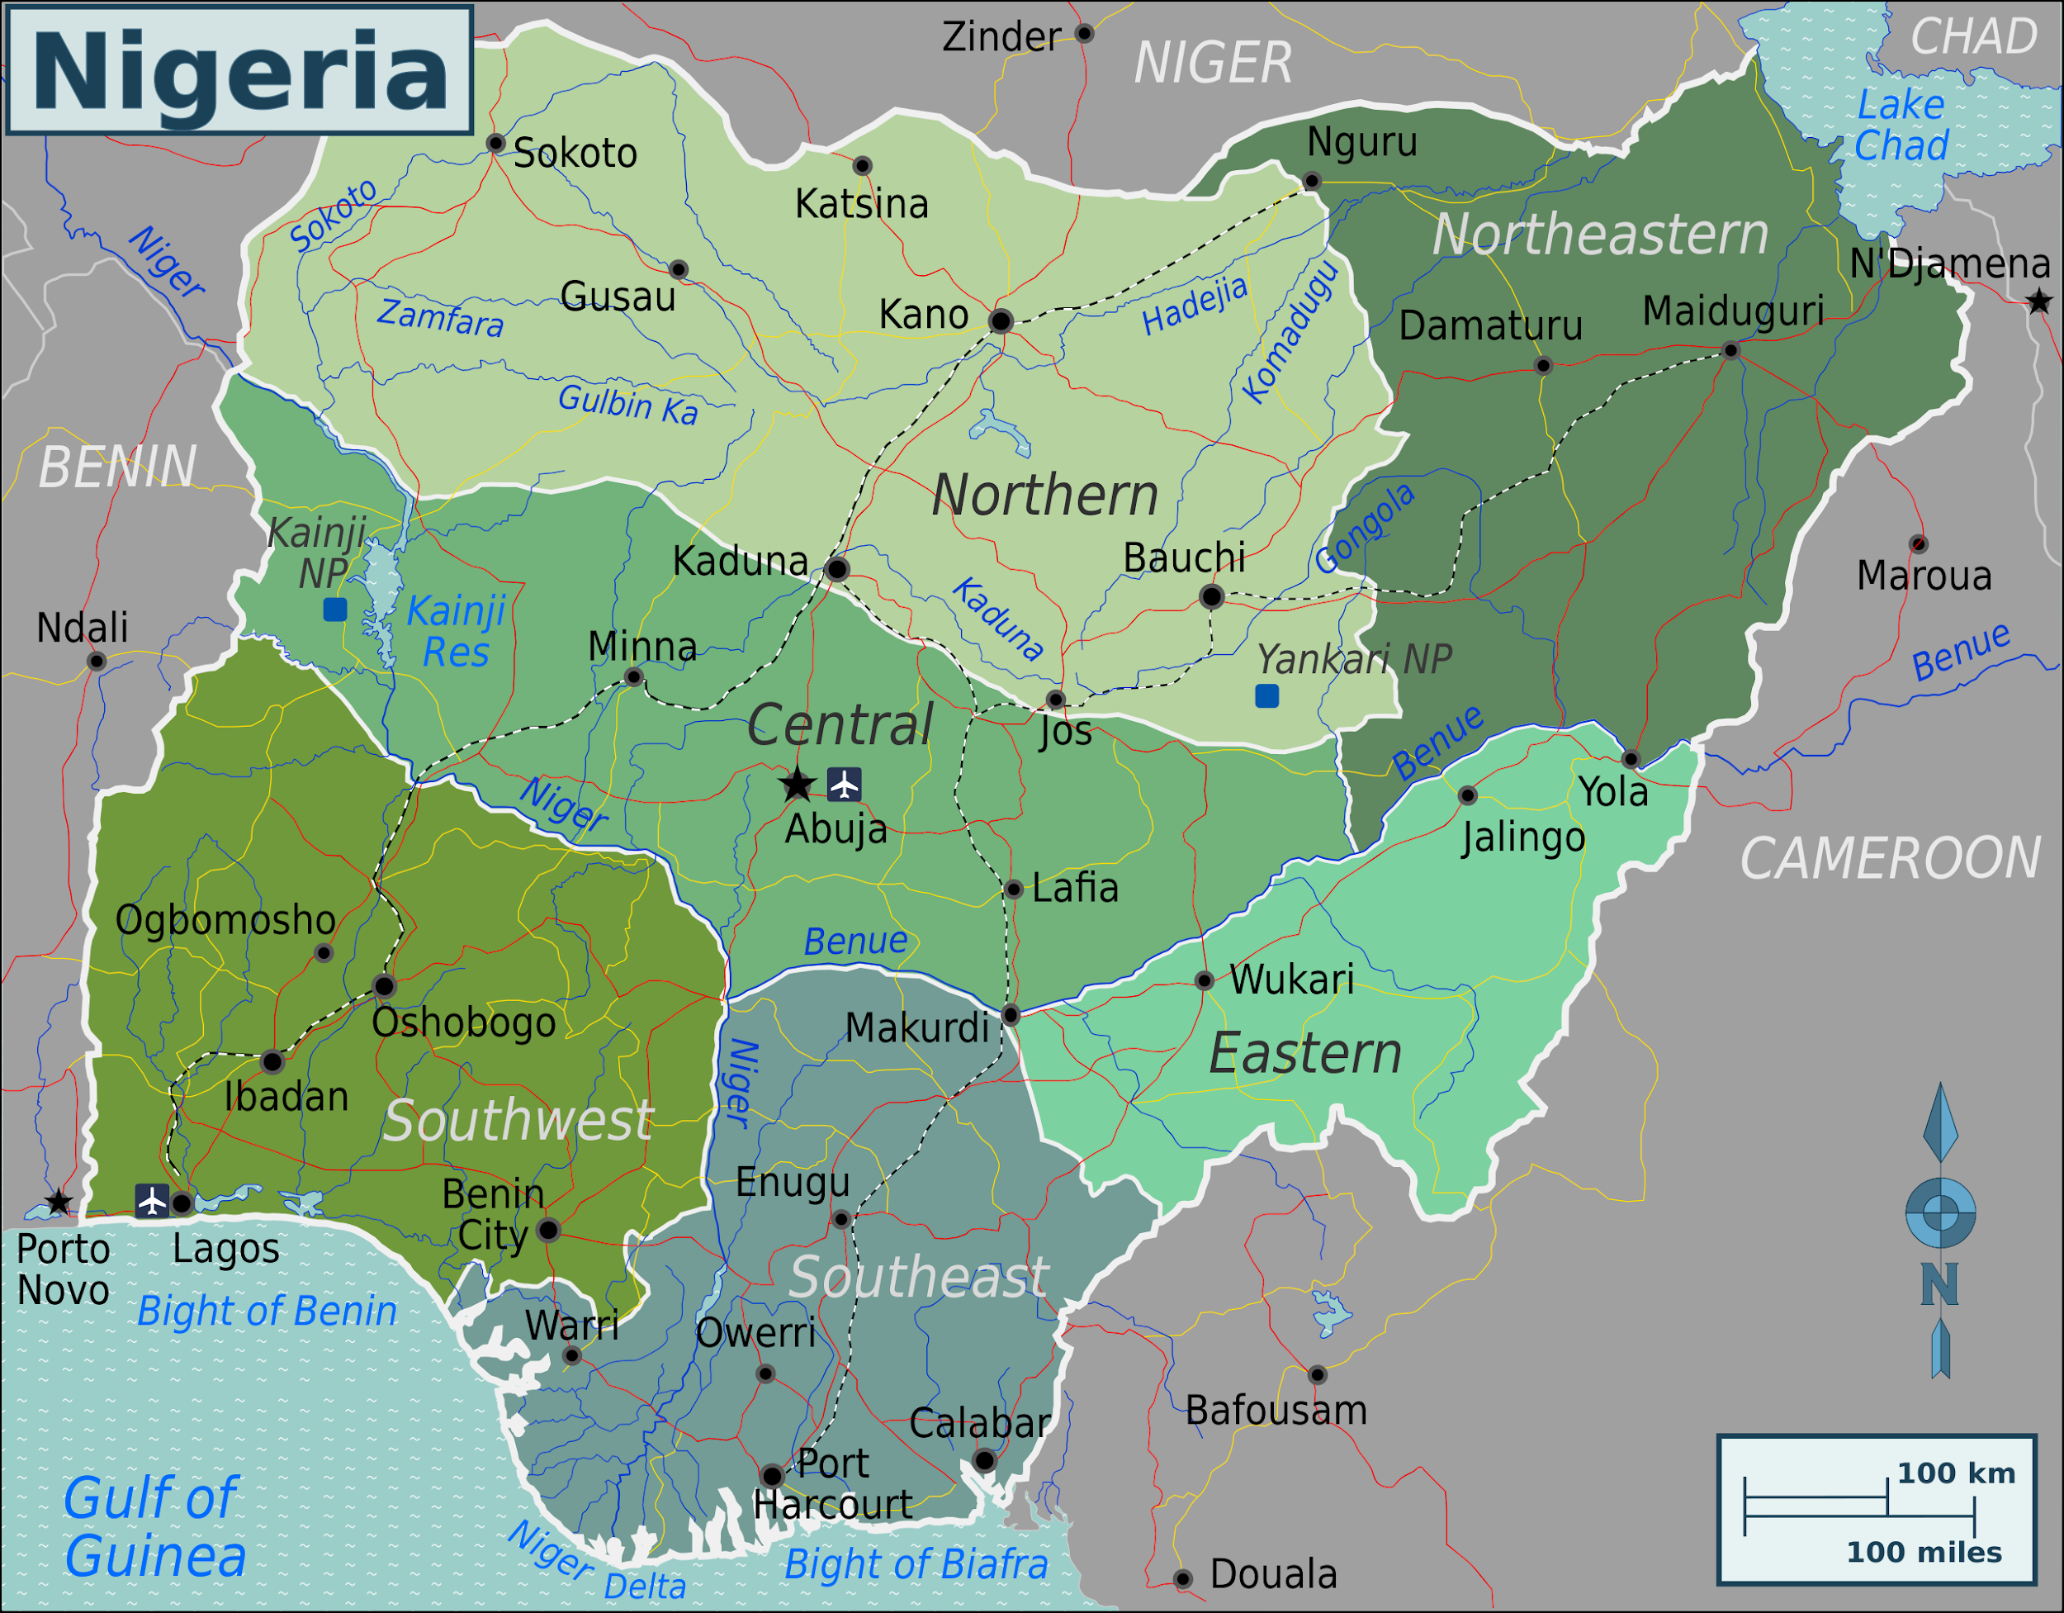

HUMAN TRAFFICKING IN NIGERIA; HUMAN CAPITAL DEVELOPMENT TOWARDS SDG’S 5 AND 4; GENDER EQUALITY AND QUALITY EDUCATION
TOWO

Slide 2

Introduction; Socio-Economic Profile
AIM- To analyse the development experience of Nigeria, with a focus on human trafficking as a human capital issue. This presentation will assess how this issue poses a challenge to Nigeria's development and the country’s readiness to tackle them in respect to achieving SDG’s 5 Gender equality and 4, quality education
Nigeria is a sub-saharan african country located in the west of the continent. Its name is derived from its proximity to the rivers Niger and Benue, which conflate within the country. The rivers empty into the atlantic located to the south. This presence of water is integral to the agricultural prominence of the country and forms valuable transport routes. Additionally, the country is bordered by Cameroon to the east and Benin to the west, who also depend on the rivers Niger and Benue respectively.
Nigeria was colonised by the British from 1884 until 1960. Prior to the 76 year formal rule of the British, Nigeria experienced Arab colonisation as well as Portuguese slave trade. In this period Nigeria experienced stolen land and forced labour, genocide, re-organised trade routes and socio- political infrastructuring to the benefit of colonists eg large scale agriculture and mining.
Though the country is no longer formally colonised, It experiences neo-colonial rule in the form of external influence in infrastructure planning, foreign debt leading to foreign control and International trade of resources to its detriment. ( Lange, 2004)
Nigeria known as the giant of Africa hosts a population of over 213 million people (World Bank, n.d).
Correspondingly, the country houses the largest economy in Africa, and 25th largest in the world, with a GDP of over $440bn as of 2021(World Bank, n.d). In the last decade of the country displaying this trend, it gained the title of a MINT country (BBC, 2014).
It is classified as a middle income country (World Bank, n.d)
Notes:
Capital of country and known for what? Black population, giant economy, 250 ethnic groups
GNI- gross national income
Explain what a MINT country is and why it is a positive thing for nigeria to be a MINT country
MPI - 0.257 suggesting what?

Slide 3
INTRODUCTION- Socio Economic profile .2
Contributors to the country’s GDP include;
Agriculture, though mostly subsistence farming. Nonetheless it accounts for 26% of the country’s GDP.
Foreign trade accounts for 23% with petroleum and liquid gas
The service sector accounts for 46% . This includes banking, retail and tourism. This sector however faces difficulty such as lack of infrastructure eg transport, electricity which undermine functioning.
Exports
Nigeria exports 70% crude petroleum and raw materials. Largely imports refined petroleum - 14.9%
In the exports profile of the country , it can be seen that Nigeria's main exports more raw materials (oil, agriculture) and imports more finished goods ( appliances, machinery, textiles)
This is partly due to the country’s lack of industrial power to eg, independently refine its crude oil. This situation is further undermined by infrastructural and institutional problems
Thus, Nigeria depends heavily on imported goods. The country exported $42.4b equivalent in 2021 and imported $52b.
Capital accumulation
Nigeria is known to have an extensive foreign investment profile. Eg received $3.36billion in 2021 (World Bank,n.d)
The country is however in severe debt, this is predicted to worsen the economic situation when repayment starts
Migrant remittance is high at $19.48billion in 2021 and higher in 2018 at $24.316billion. The country is partly dependent on remittance due to the high level of institutional weakness. Interestingly, though this dependence has been echoed by the public as a bad sign, the government have pledged to focus on increasing remittance rather than aid stability.
Notes:
Capital accumulation - foreign investment
FDI , Foreign aid
MPI - 0.257 suggesting what?
Access to electricity (% of population)
55.4
(2020)
Individuals using the Internet (% of population)
36
(2020)

Slide 4
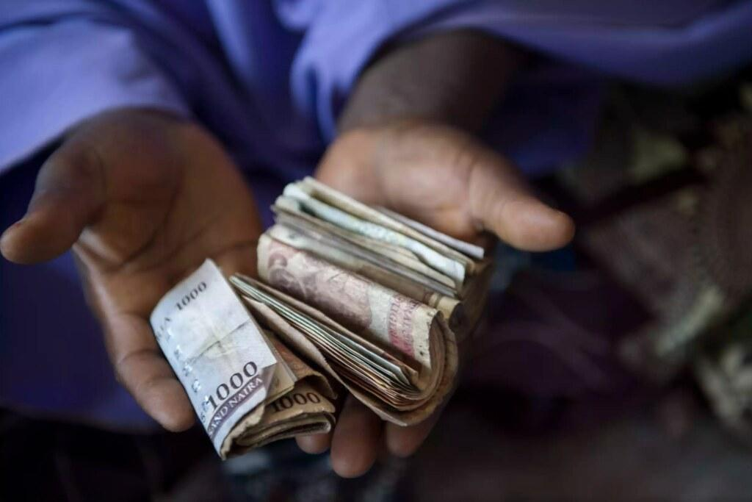
Development Experience Of Nigeria: Focus On SDG’s In Light Of Human Capital
HEALTHCARE INDICATORS ( WORLD BANK,n.d)-
Infant mortality
2013= 130 per 1000 , average 57 across LMIC’s
2023 = 111 per 1000, average 44 across LMIC’s
Maternal mortality rates per 100,000
2017= 917 vs LMIC average of 253
2000= 1,200 vs LMIC average of 422
Especially stagnant improvement when compared to the year 2000. Not much change in the last two decades in spite of GDP growth.
Life expectancy
2018 = 53 years old vs LMIC average of 69
Below average in spite of being the largest economy in africa. Shows another effect of the gross inequality in wealth distribution
EDUCATION INDICATORS - ( WORLD BANK,n.d)
Youth Literacy rate
75% vs 91% average in LMIC’s
Enrollment Gender parity index
As of 2018 - O.97 vs LMIC of 0.99
While a small gap when measured against the average, the percentage points represent potential thousands in Nigeria’s population of 230million plus.
Education disruption
Child marriage -
Adolescent fertility per 1000- 102 vs average of 43
Child labour
Engages in the worst forms of child labour, including dangeous mining, forced sexual labour and armed conflict ( US labour bereau)
Notes:
This presentation is focused on human capital as a core factor towards Nigeria’s development, thus the development experience of the country will be covered from this angle, the core indicators including Health and education.
Adolescent fertility shows three things
These girls are being statutorily raped which carried negetive psycological effects, impacting both their wellbeing and ability to contribute to the economy
They are not going to school. Instead they take on the labour of motherhood which means they cannot contribute financially to their households or exercise agency in economic options ( amartya sen)
This reproduces and continues to contribute to maternal mortality both for adults and adolescents. This is because uneducated mothers cannot adequately care for their children. Those same children if female, end up in child marriages too, unable to pursue further proper education, both in regards to child/ family care and economic participation.
Additional point - this socio economic distress is not experienced by their male counterparts

Slide 5

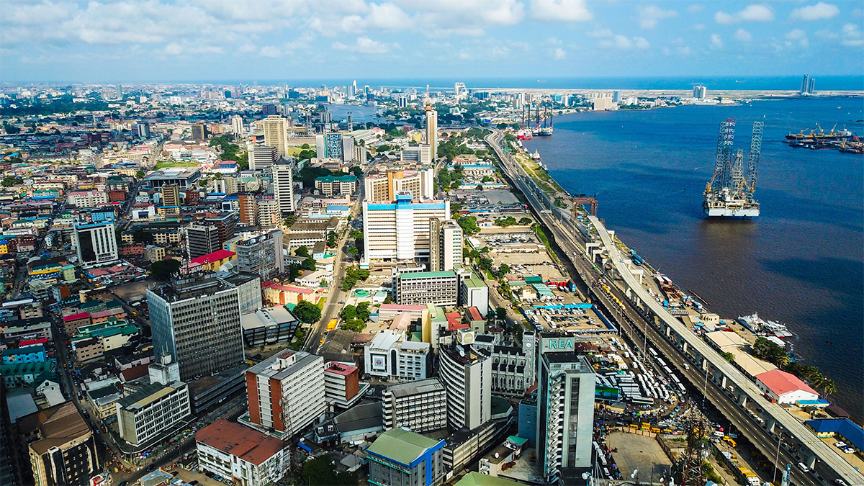
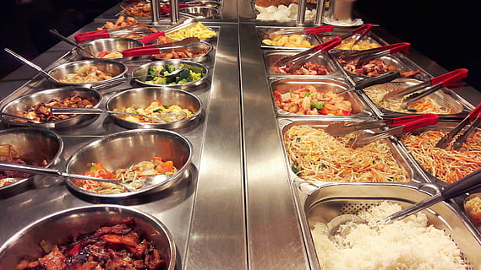
The Impact of Covid 19 & the Ukraine War On the Nigerian Economy
OIL TRADE UKRAINE
Ukraine conflict has fuelled recession in nigeria of over 16.9% in 2022 as a result of supply disruptions caused by the war
( AFDB,2022)
Impact Of Covid On Economic Development
34.1% loss in GDP. Largest contributing factor to the loss derived from the services sector. (IFPRI 2020)
Resulted in increase in poverty
GDP loss only temporary as though it fell from 442b to 438b, as of 2021 it is 440b.
Government initiatives include
National digital economy policy
Nigerian tourism development master plan
Postal service reform ( lloyds bank, 2023)
These aim to build transport, logistics, digital and internet based infrastructure to keep up with the changing business environment and for smoother running and recovery of businesses and sectors that suffered uniquely in this way due to covid eg the service sector including retail, entertainment and banking

Slide 6
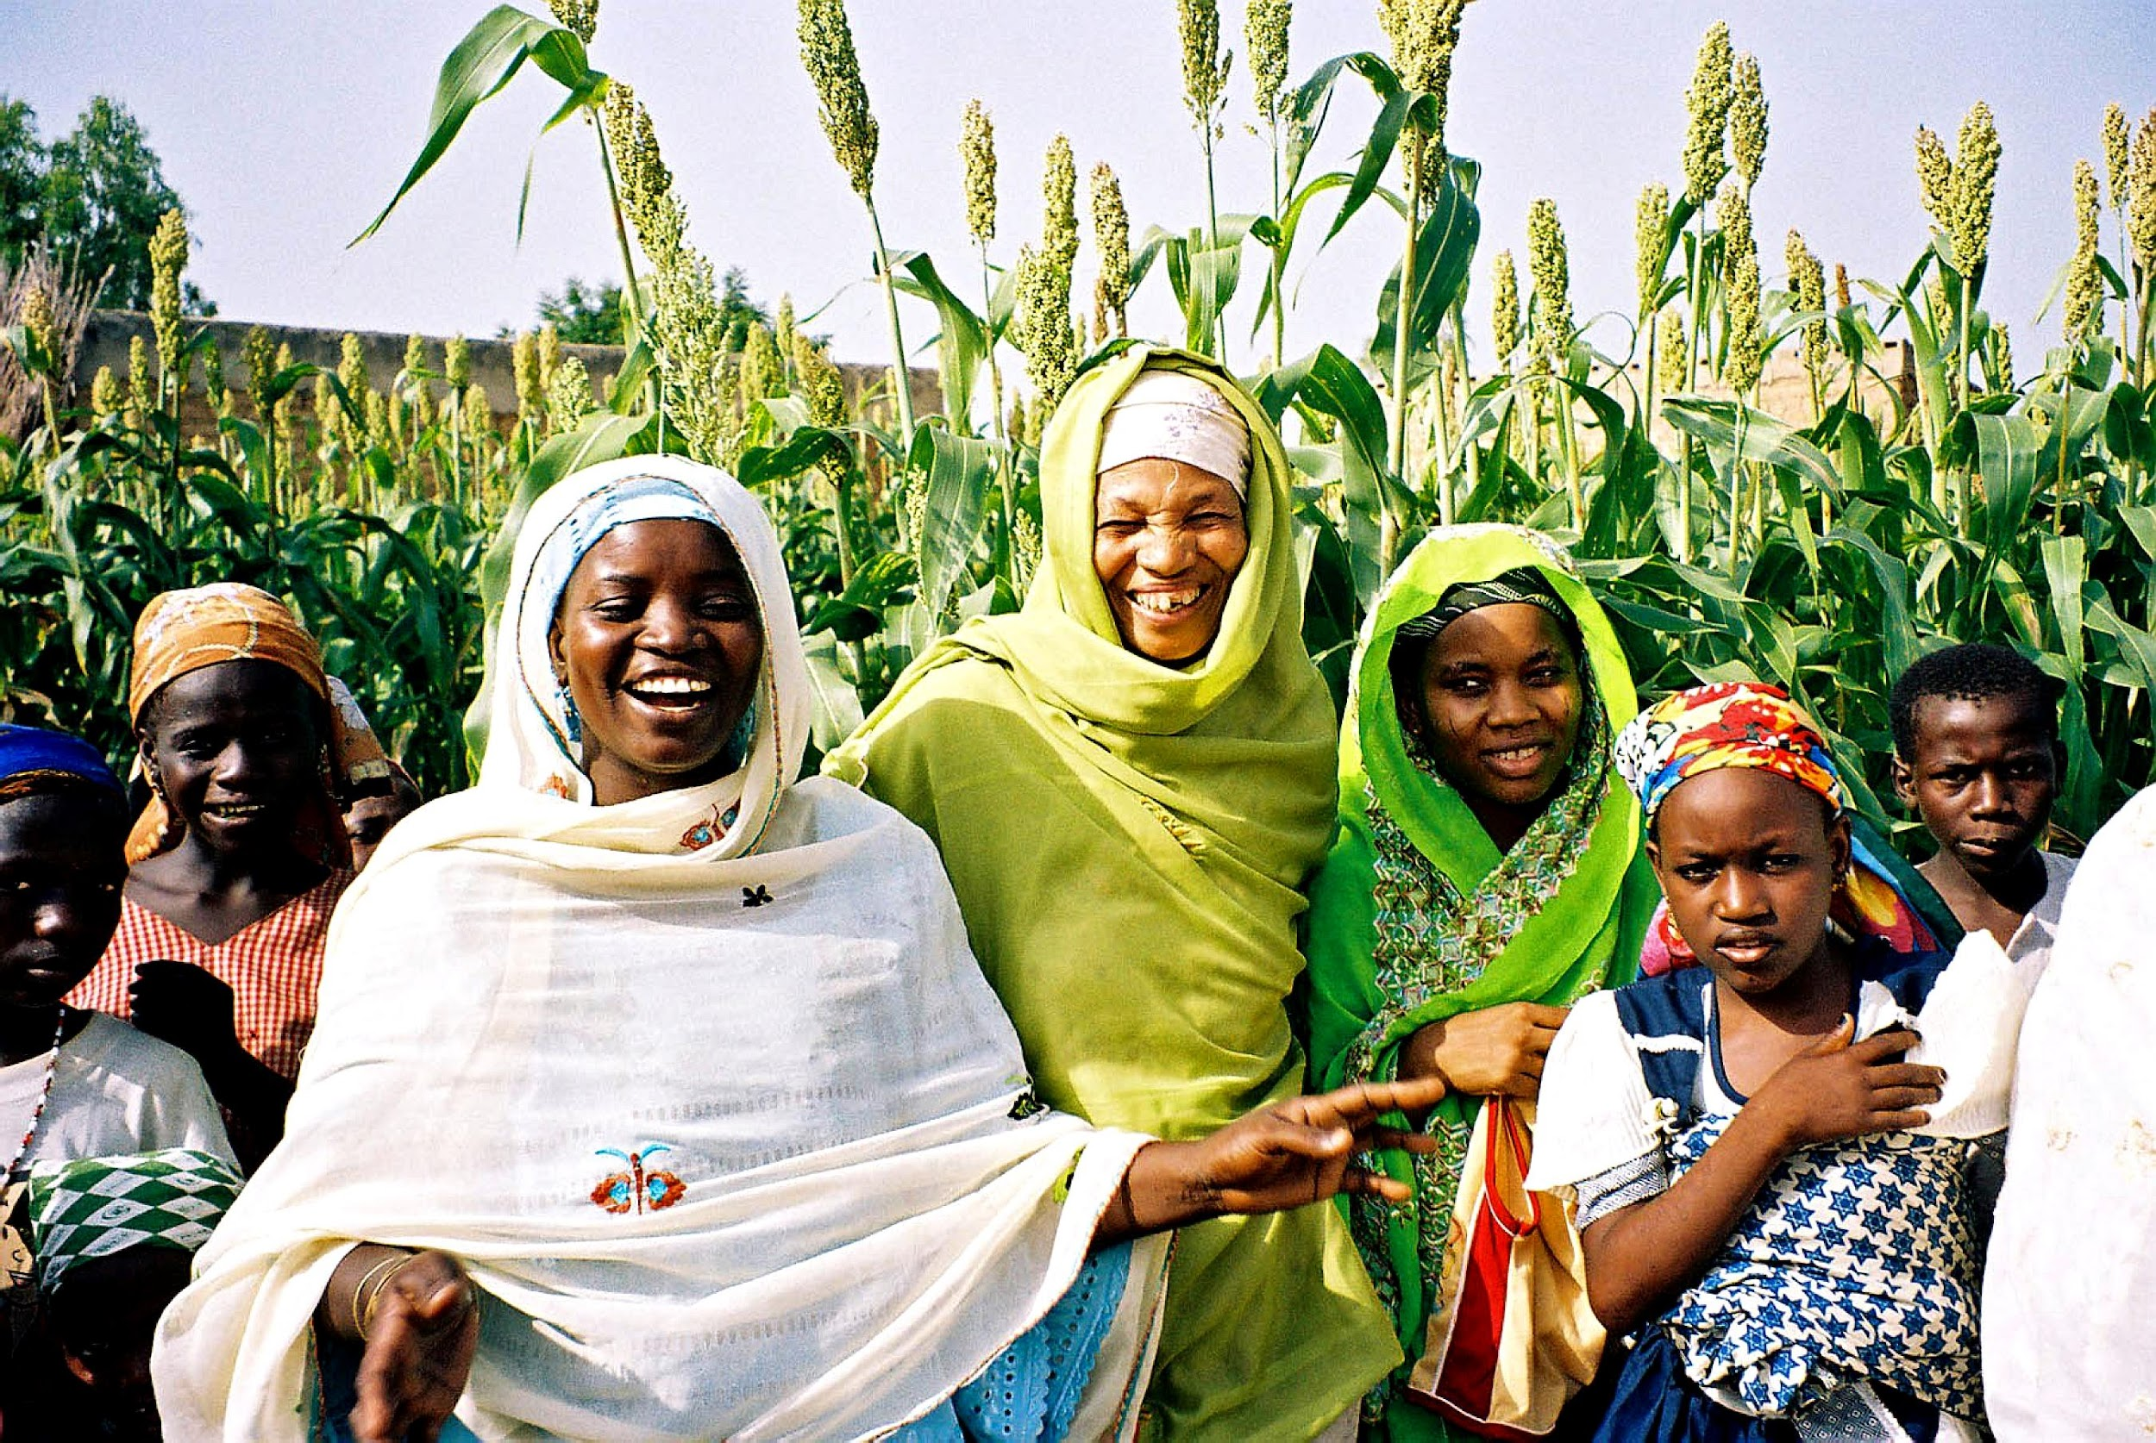
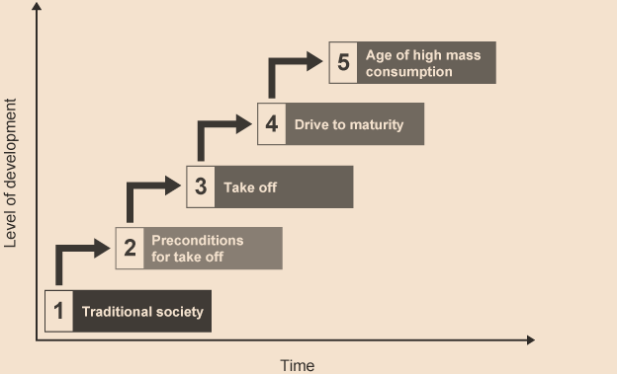
Lewis Turning Point And Rostow's Model Analysis
Lewes Turning Point Analysis
Agriculture contributes 23% to GDP in 2021 while Manufacturing / Industry contributed only 15% (World Bank, 2021).
For a country to reach lewes turning point they must show a move away from being a dominantly agricultural society. According to this, Nigeria does not look to be reaching the lewes turning point.
This is because,while the country is receiving Investment from the world bank towards diversifying its economy(World Bank, 2021), serious challenges remain to becoming more industrial; human capital, energy and poor infrastructure - transport. Poor institutions ; education. Additionally, it is feared that the population is growing at a faster pace than the economic capacity.
Criticism of this analysis is that Nigeria’s wealth leaves in form of ‘capital flight’. Capital flight effect on lewes turning point
Historically and current wealth generated, particularly from its petroleum and natural gas industries and additionally, labour in form of ‘brain drain’.
Rostow’s growth model analysis
Argued to be IN take off stage as of right now due to diversification in the form of digitisation (Punch news, 2022).
however , is not too closely replicated because has elements of eg, subsistence farming

Slide 7
Human trafficking in Nigeria - a gendered issue
Human trafficking in this context refers specifically to sex slavery, forced prostitution and forced impregnation for commercial purposes. Focus will be given to forced impregnation.
This happens due to sociocultural stigma of childlessness due to marriage being a strong institution in the country. Additionally, adoption is a stigmatised and long winded process inaccessible to the poor thus this becomes a viable option.(Okoli, Eze, 2021)
Here, women are kept against their will, in most cases kidnapped and repeatedly raped for the purpose of impregnation and ultimately selling the children. This happens in places disguised as orphanages, religious institutions etc. While this forced surrogacy is the focus, there occurs a mix of sex slavery, forced prostitution, and domestic labour, involving the children and women as products. (Human Rights Pulse, 2021)
Determining the gendered nature of this issue
79% of victims of human trafficking globally are women and girls. In addition, this industry makes $150billion annually, forming a lucrative underground economy.
Nigeria ranked 32nd out of 167 with a high number of enslaved - 1,386000. While 61% occurs within the borders, 39% of victims are smuggled across borders with high numbers crossing the ‘deadly’ mediterranean to Europe. Additionally the UAE receives a high number of trafficked nigerian women and girls, having the highest number of rescued nigerians in 2020 (‘Nigeria: Human Trafficking Factsheet’, 2022)
A bubbling issue
Poverty is the highest driving factor of human trafficking. Additionally there is climate change, insecurity and corruption. Particularly rampant is the widespread gendered violence that makes even the transport systems unsafe
Notes:
Individuals using the Internet (% of population)
36
(2020)

Slide 8
Human Trafficking In Nigeria- SDG’s 5 And 4- Gender Equality, Quality Education
Gender equality- Gender equality cannot be acheived until this is seriously addressed. Women and girls, particularly of the 49% living in extreme poverty, face constant threat of human trafficking. This pervades every aspect of life , such as public transportation. They are unable to act with agency and/ or amartya sen’s freedom to choose.
Rob the country of a potentially productive labour force that may work towards improving society in both social and economic ways, eg administrative roles.
Quality education- while nigeria has high rates of education enrollment in the younger groups, the quality of education delivered must be made relevant to sensitive social issues, to have a chance of acheiving SDG 4. In the case of human trafficking, a better understanding of the issue has been proposed tol tackle the ignorance that enshrines it.(Chigbu, 2018)
The established gender inequality further acts as a bar to the country achieving sdg quality education as they are the demographic that may continue to miss out on education and potentially the development of the educational sector.

Slide 9
Government // Foreign Initiatives and Critique
National initiatives
Nigerian agency - NAtional agency for the prohibition of trafficking in persons ( NAPTIP)
Initiates educational campaigns with collaborators and people in rural // poor areas
Collaborates with police to ensure enforcement of prison sentences
Collaborates with airports which is the site of transportation of trafficked people (Philipp, J. ,2021)
Abortion remains illegal in Nigeria, entrenched in the Penal code and the criminal code. Except where the mothers life is in danger it attracts a prison sentence of 7- 14 years (Chigbu, 2018)
Is said to contribute to high maternal mortality rate due to the dangerousness of the practice done illegally
Foreign initiatives
World bank approved loan of $3.9million, under ‘Unbrella organiasation to support nigeria for womens project ( World bank, 2023)
Aims to tackle issues relating to womens empowerment such as domestic violence and health care acess
Results remail to be seen
International modern slavery protection
Nationality borders act 2022 - cahnnelled towards boat migrants
Current agreement with france targeted towards boat migrats - Free space for uninterrupted practice of trafficking with criminalisation and stripped protections from the UK
Notes:
The criminalisation has led to the wide spread practice of illegal and unsafe abortions. In the context of human trafficking, this gap of protection in the law is the area of exploitation of traffickers
International modern slavery protection
Places like the UK however, once a place of asylum have modified its modern slavery / immigration laws to pull away protection and promote criminality of undocumented migrants, refugees and asylum seekers. This has affected will affect victims of human trafficking the most.

Slide 10
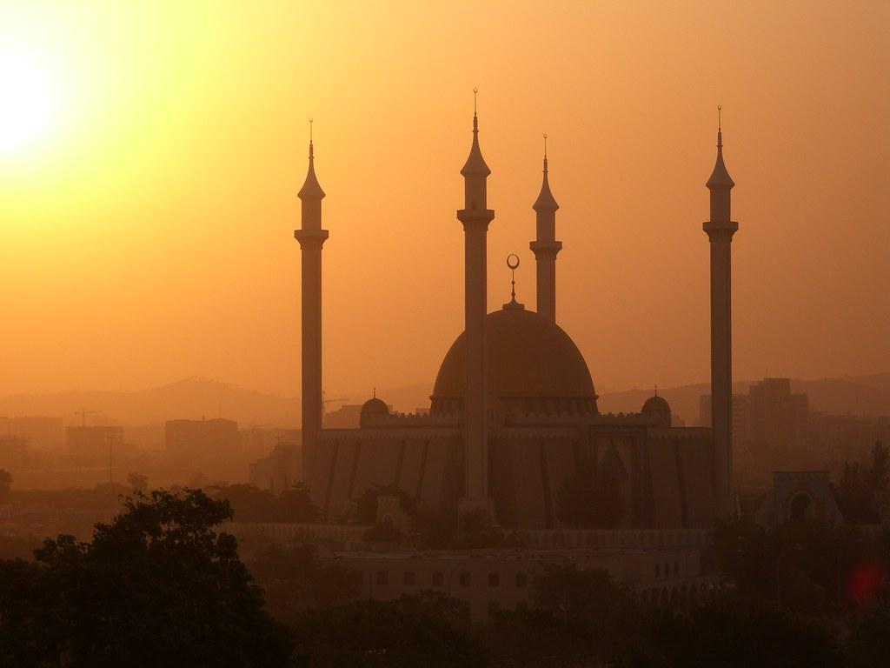
Conclusion
Nigeria is culturally diverse and resource rich in land, minerals and workable soil. Despite many years of british colonialism ( within living memory) where it faced the horrors of slave trade, societal restructuring and resource extraction, the country - culture, people and resources remain. Nigeria is however faced with extreme poverty and inequality, with a population growth rate predicted to surpass its ability to maintain cohesive development. Additionally the country is over-dependent on oil and agriculture, both of which at a large scale level contribute to soil erosion and worsening climate change .
Nigeria experiences multi dimensional poverty, with necessities like electricity being available to less than half of the population. Its development markers are poor- mortality, life expectancy etc. In light of covid and the ukraine war, it experineces irrecoverable damge to infaltion and oil trade.
Human trafficking has been examined as a global issue that is also deeply gendered. A lack of legal protection, extreme poverty and comprehensive education, in addition to social stigma, make poor nigerian woman and girls vulnerable targets. Not only are they left with psychologically irreparable damage, this prevents them from participating in society and the economy like theior male counterparts.
The human trafficking problem acts as a bar to nigeria reaching the sdg 4 quality education and sdg 5 gender equality. Trafficked people my never go back to school or may face extreme difficulties. Gender eqality cannot exist until women and girls are seen as people with agency rather than reproductive , sexual and domenstic commercial products. As these issues are additionally underpinned by the extreme poverty problem faced by nigerians, these goals may not be reached any time soon.
Notes:
Can Nigeria reach these sdg’s?
NO. Not at the current pace of development. Not within the current framework. And not alone.
Current framework with neocolonial foreign influence stagnates the countries development with the aim of development- a paradox. This happens in form of ;
Climate change will contribute to development, but oil and and agricultural which degrade the environment

Slide 11
REFERENCES
BBC News (2014) ‘The Mint countries: Next economic giants?’, 6 January. Available at: https://www.bbc.com /news/magazine-25548060 (Accessed: 12 March 2023).
Child Harvesting: A Closer Look At The Rising Business Of Baby Factories In Nigeria (2021) Human Rights Pulse. Available at: https://www.humanrightspulse.com/mastercontentblog/child-harvesting-a-closer-look-at- the-rising-business-of-baby-factories-in-nigeria (Accessed: 12 March 2023).
Human Capital Index (HCI) (scale 0-1) - Nigeria | Data (no date). Available at: https://data.worldbank.org /indicator/HD.HCI.OVRL?locations=NG (Accessed: 12 March 2023).
Largest Countries in Africa 2023 (no date). Available at: https://worldpopulationreview.com/country-rankings /largest-countries-in-africa (Accessed: 9 March 2023).
Multidimensional Poverty Measure (no date) World Bank. Available at: https://www.worldbank.org/en/topic
Economics, D. (2023) Developing Economics, Developing Economics. Available at: https://developingeconomics.org/ (Accessed: 9 March 2023).
‘Enough of Nigeria’s dependence on diaspora remittances’ (2021) The Guardian Nigeria News - Nigeria and World News, 18 October. Available at: https://guardian.ng/opinion/enough-of-nigerias-dependence-on-diaspora- remittances/ (Accessed: 22 March 2023).
Esidene, E.C. (2012) ‘ECONOMIC DEVELOPMENT AND MASS POVERTY IN AFRICA: ASSESSMENT OF THE NIGERIAN EXPERIENCE’, 3(3).
Findings on the Worst Forms of Child Labor - Nigeria (no date) DOL. Available at: http://www.dol.gov /agencies/ilab/resources/reports/child-labor/nigeria (Accessed: 25 March 2023).
How US-linked Organisations Are Funding Anti-abortion Campaigns With Misinformation In Nigeria, Others | Sahara Reporters (no date). Available at: https://saharareporters.com/2020/02/11/how-us-linked-organisations- are-funding-anti-abortion-campaigns-misinformation-nigeria (Accessed: 25 March 2023).
Human Capital Index (HCI) (scale 0-1) - Nigeria | Data (no date). Available at: https://data.worldbank.org /indicator/HD.HCI.OVRL?locations=NG (Accessed: 12 March 2023).
Lange, M.K. (2004) ‘British Colonial Legacies and Political Development’, World Development, 32(6), pp. 905–922. Available at: https://doi.org/10.1016/j.worlddev.2003.12.001.
Largest Countries in Africa 2023 (no date). Available at: https://worldpopulationreview.com/country-rankings /largest-countries-in-africa (Accessed: 9 March 2023).
Manufacturing, value added (% of GDP) - Nigeria | Data (no date). Available at: https://data.worldbank.org /indicator/NV.IND.MANF.ZS?locations=NG (Accessed: 24 March 2023).
Multidimensional Poverty Measure (no date) World Bank. Available at: https://www.worldbank.org/en/topic /poverty/brief/multidimensional-poverty-measure (Accessed: 12 March 2023).

Slide 12
REFERENCES- Contd.
Nations, U. (no date) Specific country data, Human Development Reports. United Nations. Available at: https://hdr.undp.org/data-center/specific-country-data (Accessed: 12 March 2023).
NBS: 133m Nigerians Living in Poverty – THISDAYLIVE (no date). Available at: https://www.thisdaylive.com /index.php/2022/11/18/nbs-133m-nigerians-living-in-poverty/ (Accessed: 24 March 2023).
Nigeria | Data (no date). Available at: https://data.worldbank.org/country/nigeria (Accessed: 13 March 2023). Nigeria at a glance | FAO in Nigeria | Food and Agriculture Organization of the United Nations (no date).
Available at: https://www.fao.org/nigeria/fao-in-nigeria/nigeria-at-a-glance/en/ (Accessed: 24 March 2023). ‘Nigeria: Human Trafficking Factsheet’ (no date). Available at: https://pathfindersji.org/nigeria-human-
trafficking-factsheet/ (Accessed: 22 March 2023).
Nigeria (NGA) Exports, Imports, and Trade Partners | OEC (no date) OEC - The Observatory of Economic
Complexity. Available at: https://oec.world/en/profile/country/nga (Accessed: 21 March 2023). Okpala, A.O. (1990) ‘Nigerian population growth and its implications for economic development’,
Scandinavian Journal of Development Alternatives, 9(4), pp. 63–77.
‘On Nigeria’s drive to digital economy’ (2022) Punch Newspapers, 27 October. Available at:
https://punchng.com/on-nigerias-drive-to-digital-economy/ (Accessed: 27 March 2023).
(PDF) ‘Baby factories’ versus the objectification of surrogacy cum child adoption in Nigeria (no date). Available at: https://www.researchgate.net/publication /351482893_%27Baby_factories%27_versus_the_objectification_of_surrogacy_cum_child_adoption_in_Nigeria (Accessed: 10 March 2023).
Philipp, J. (2021) The Fight Against Human Trafficking in Nigeria, The Borgen Project. Available at:https://borgenproject.org/human-trafficking-in-nigeria/ (Accessed: 27 March 2023).
The Colonial Era (1882-1960) (no date). Available at: https://rpl.hds.harvard.edu/religion-context/country- profiles/nigeria/colonial-era-1882-1960 (Accessed: 21 March 2023).
The economic context of Nigeria - International Trade Portal (no date). Available at:https://www.lloydsbanktrade.com/en/market-potential/nigeria/economical-context?vider_sticky=oui (Accessed: 27 March 2023).
These are the four largest sectors of the Nigerian economy - Nairametrics (no date). Available at:https://nairametrics.com/2022/03/10/largest-sectors-of-nigerian-economy-in-2021these-are-the-four-largest- sectors-of-the-nigerian-economy/ (Accessed: 21 March 2023).

